Slide 1
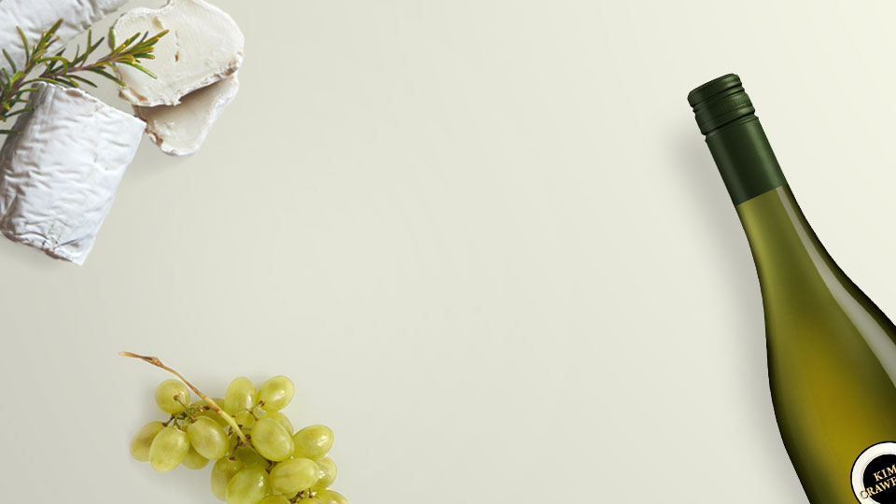
Uncovering Regional Differences in Wine based on Wine Descriptions
By: Chris Tarzian, Brian Rochford, Kevin Chavez, Baris Baturay and Dayany Euceda
Group 12
5/5/2022

Slide 2
*** Quick Note
After receiving feedback from the professor during the presentation, we pivoted our project a little bit and focused our dataset to top regions throughout the world.
This allowed for higher performing models and more unique insights.

Slide 3
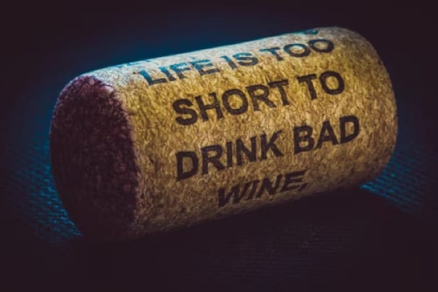
Introduction
“Beer is made by humans, wine by God.”
Wine is a universal language; enjoyed across country, language and culture
Oldest known winery dates back 6,100 years to a recently discovered cave in Armenia
Types: Red, White, Rose, Sparkling, Dessert, etc.
Understand regional characteristics for wine
Gain insight on which words are used to describe wine

Slide 4
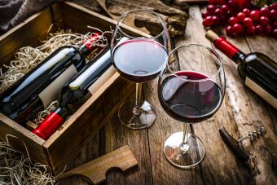
Problem Statement
We sought to analyze wine descriptions by region/county to discern if there were noticeable differences in wine characteristics.
We also aimed to provide a list of top wineries based on points (rating) and prices

Slide 5
Methodology
Data Collection
Text Processing and
Data Manipulation
Topic Modeling
Sentiment Analysis
Exploratory Data Analysis
TF-IDF Representation
Model for Quality Prediction
Model for Classifying Regions
Multilayer Perceptron
Random Forest
Random Forest
Multilayer Perceptron
Multilayer Perceptron

Slide 6
Data Description
Data is downloaded and aggregated on Kaggle
200,000+ rows
Columns: Price, Country, Description, etc.
14 columns (11 String, 3 Integer)
https://www.kaggle.com/zynicide/wine-reviews
Regions | Wineries | Wine Bottles
1,300+ | 19,000+ | 118,000+

Slide 7
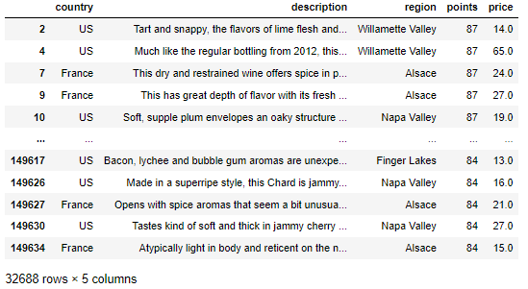
Data Description Continued
Initially narrowed down dataset to 6 US regions/counties on the west coast
Pivoted into more diverse regions from around the world
8 regions (Willamette Valley, Alsace, Napa Valley, Mendoza, Columbia Valley, Toscana, Finger Lakes and Rioja)
32,688 unique wine bottles

Slide 8
Text Preprocessing and Data Manipulation
Remove non-alphabetical characters
Tokenization
Removed Stop Words
Stemming
Lemmatization
TF-IDF representation for 1000 most used keywords to control do document frequencies
Dropping Duplicates
Replacing null values with medians
Scaling price and points
Eliminating outliers with distribution quartiles
Dropping null values
Focused on Western US Regions

Slide 9
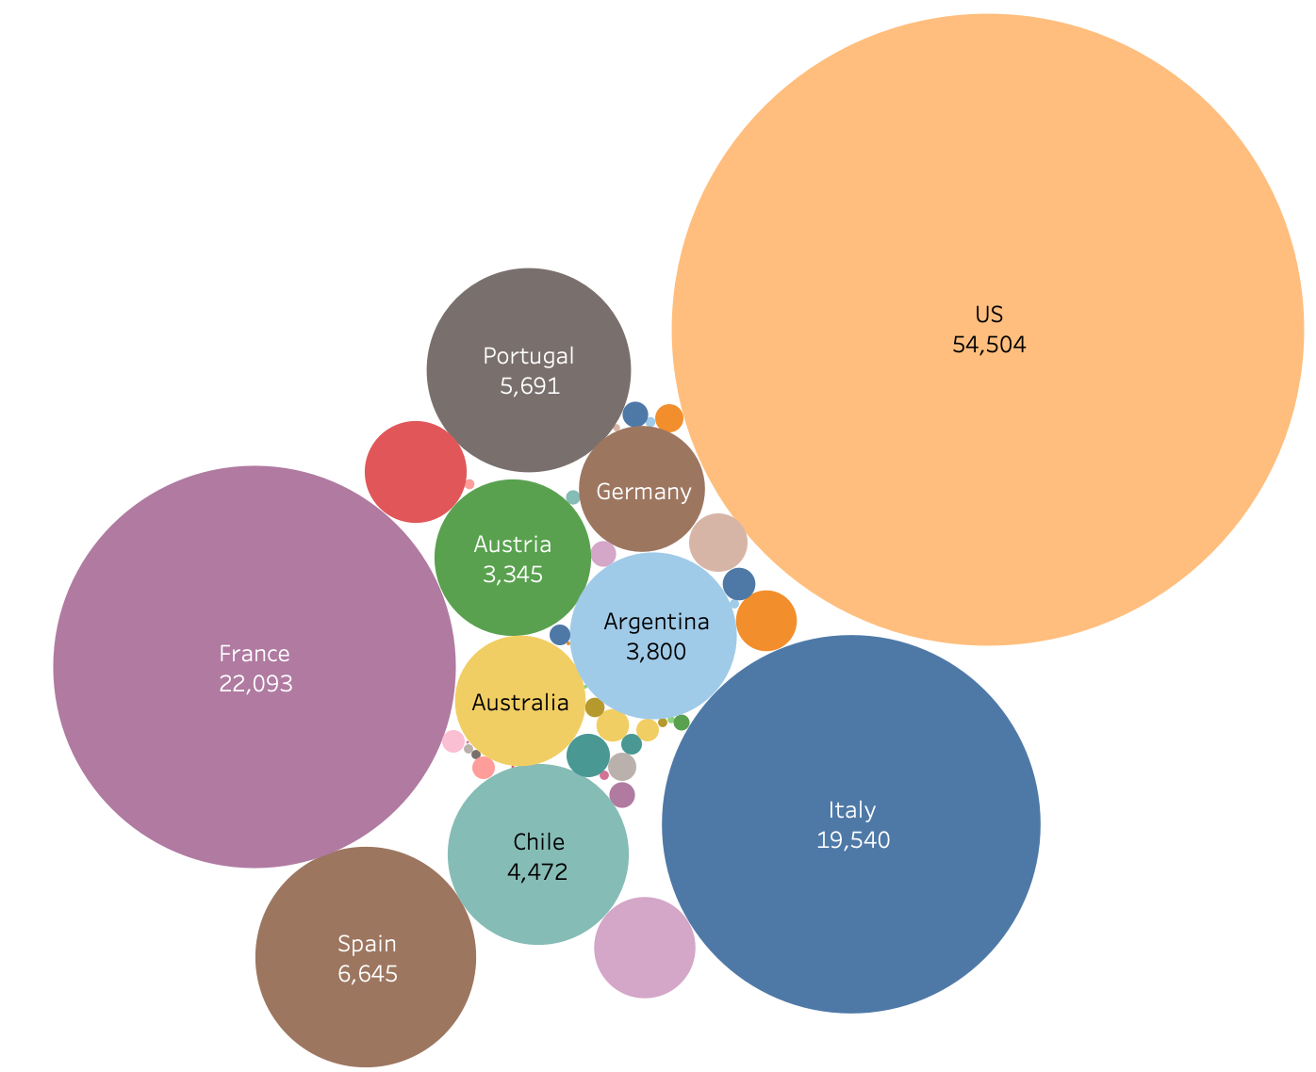
Exploratory Data Analysis
Initially grouped dataset by country
US, France and Italy had the most contributions to dataset
We felt that comparing bottles and wineries by country would yield results with minimal insight

Slide 10
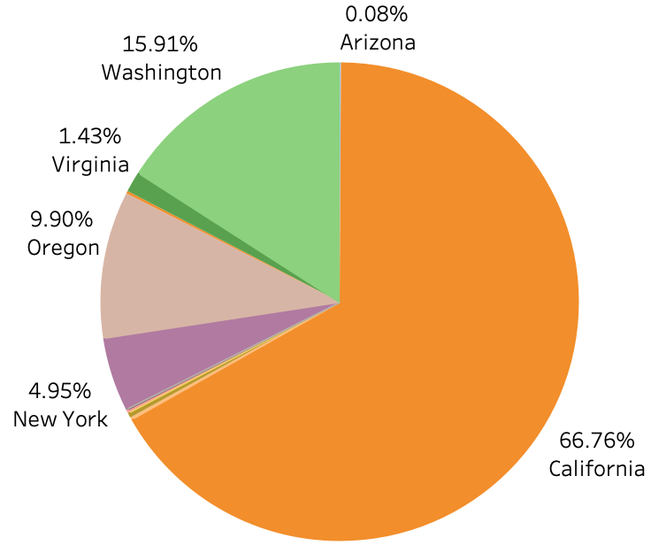
Initial Exploratory Data Analysis Cont’d
Chart shows data distribution across the US
92.57% of United States wine descriptions came from wineries in California, Washington, and Oregon
Based on this, we decided to hone in on those three states

Slide 11
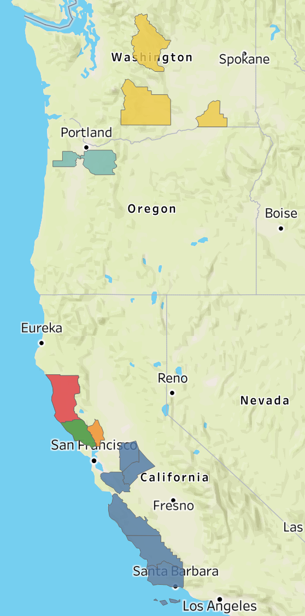
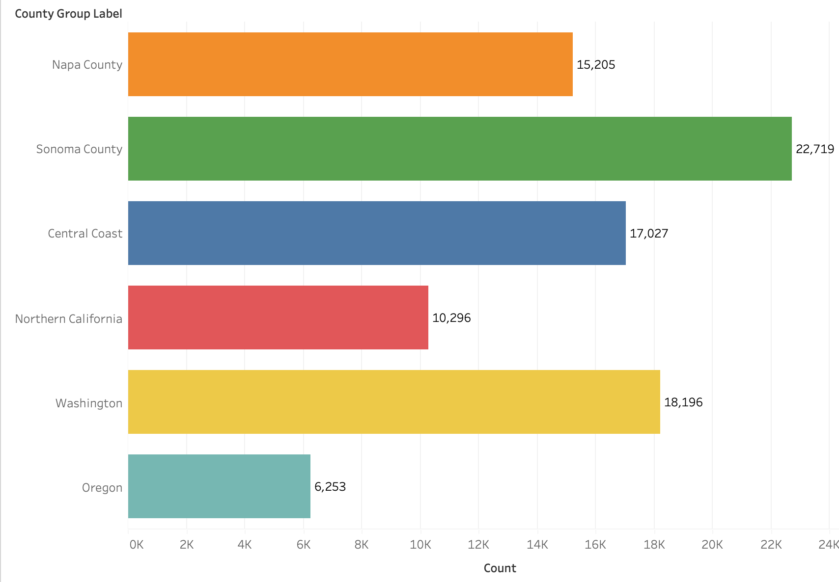
Initial 6 Major Regions/Counties

Slide 12
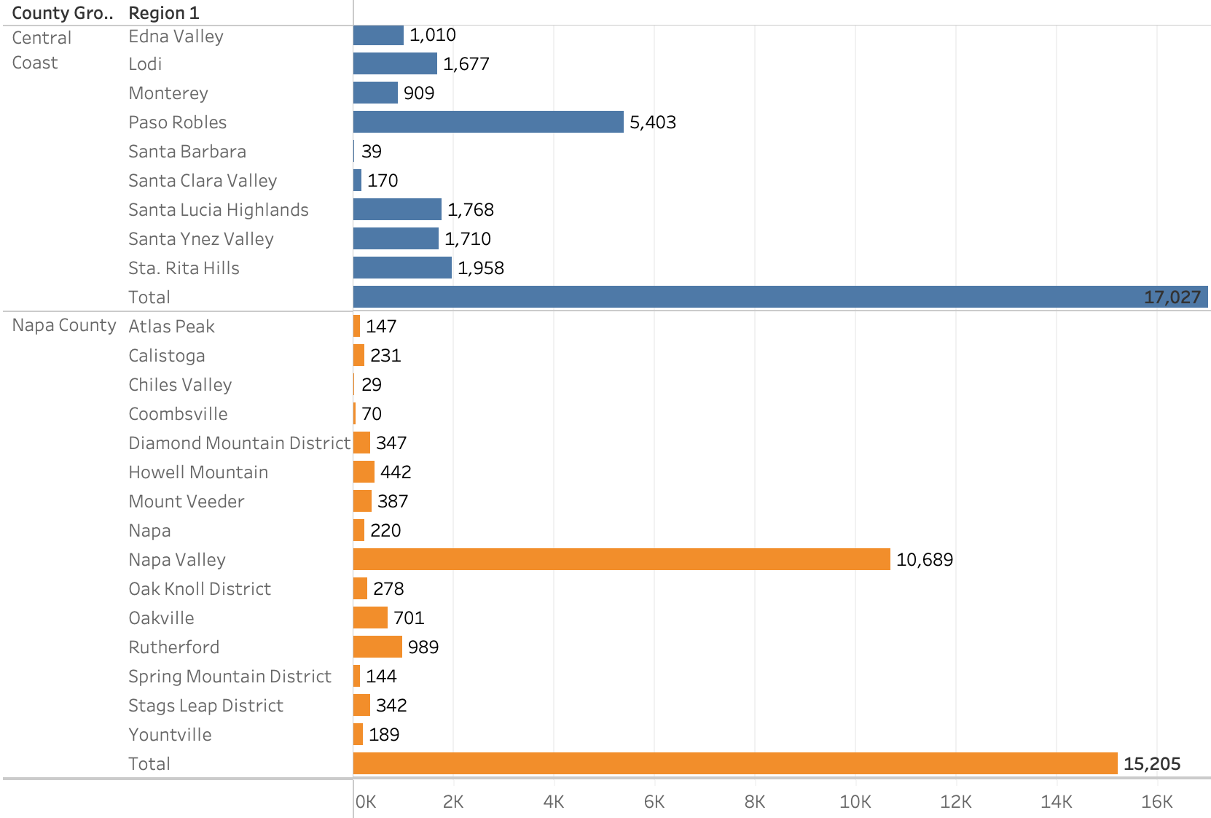
Initial Insight on the Regions/County
After visualizing the region labels with the largest row counts, we discovered most were AVA’s (American Viticultural Areas) within popular west coast winery regions
American Viticultural Area - designated wine grape-growing region in the United States, this appellation label benefits both wineries and consumers. Allows for differentiating wine based on geographic location and the distinguishable climate conditions that come with it

Slide 13
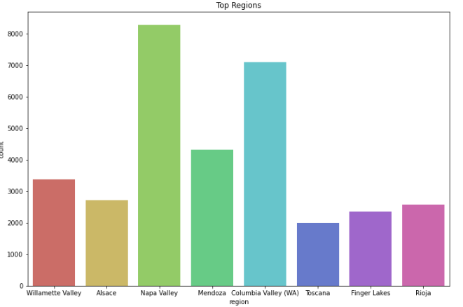
Final Exploratory: 8 Major Regions in World
Willamette Valley (OR)
Alsace (France)
Napa Valley (CA)
Mendoza (Argentina)
Columbia Valley (WA)
Toscana (Italy)
Finger Lakes (NY)
Rioja (Spain)

Slide 14

Model Construction
Regression Models
Multilayer Perceptron Regressor
Random Forest Regressor
Classification Models
Multilayer Perceptron Classifier
Random Forest Classifier
Logistic Regression
Evaluation
Precision
Recall
f1-score
Variables Used
Normalized price and points on a 0 to 1 scale
Stem words from descriptions of all wine bottles coming from a winery in specific regions
Region Label (1-6)
Descriptions are represented as TF-IDF.
Train/Test Split: 70/30

Slide 15
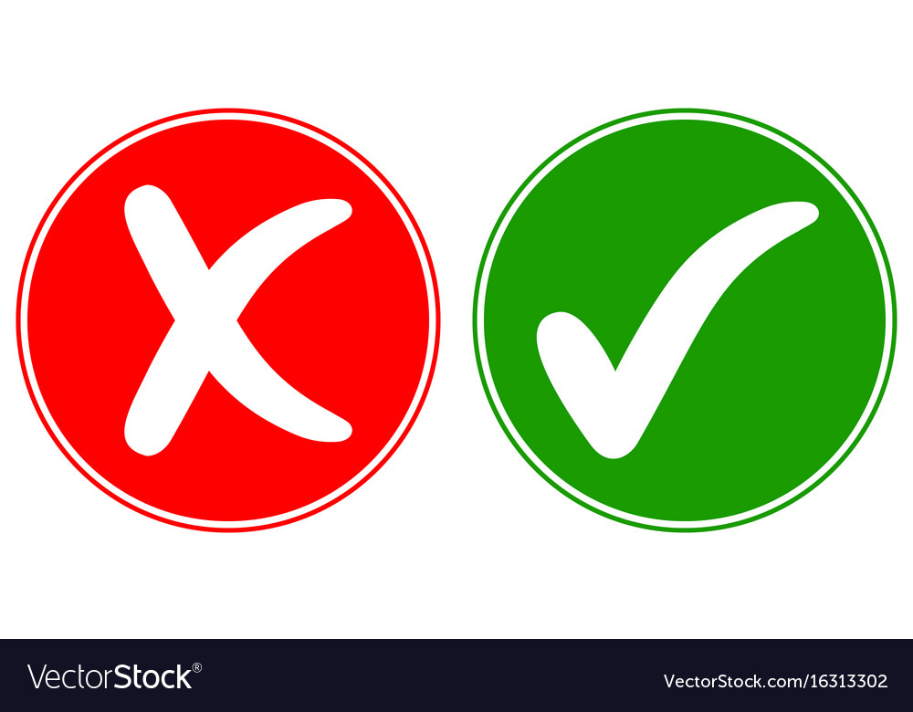
Predicting Wine Quality
 | MLP Regressor | Random Forest Regressor
Root Mean Squared Error | 0.0777 | 0.0837
R2 Score | 0.7563 | 0.7176
0.30 Train-Test Split

Slide 16
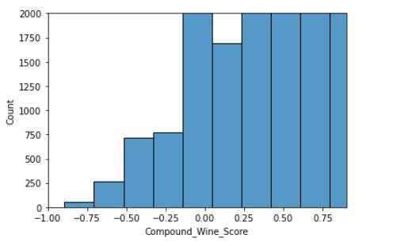
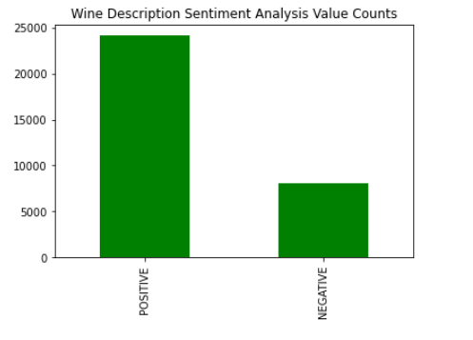
Sentiment Analysis
Ran the Vader sentiment analyzer tool on our wine description variable
Compound Polarity Score Distribution is skewed to the right as you can see in Figure 1
The wine description column did not typically include the reviewers opinion on the wine and mostly described its taste, flavor and scent.

Slide 17
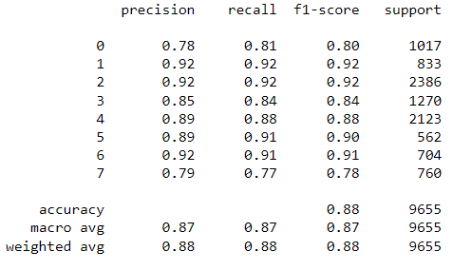
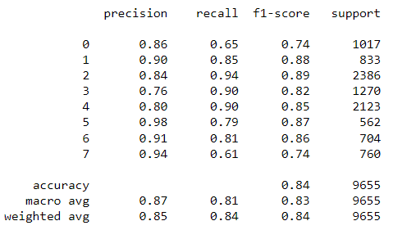
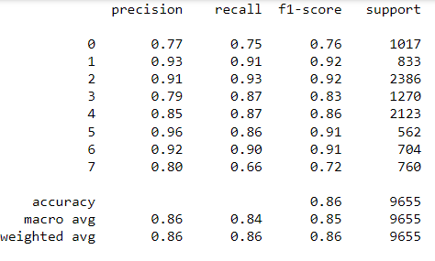
Classifying Regions
Multilayer Perceptron
Random Forest
Logistic Regression

Slide 18
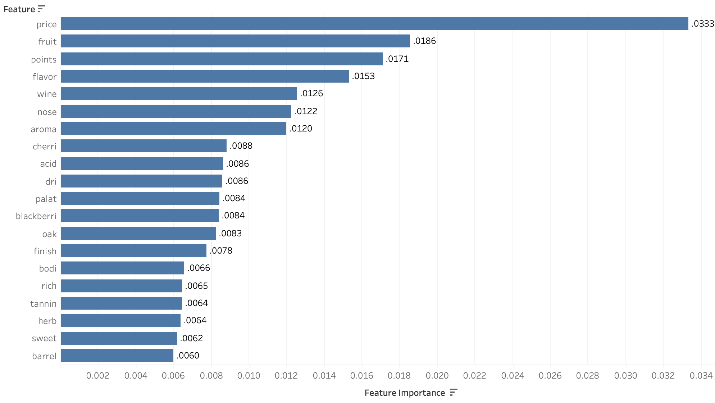
Feature Importances Region Classifier

Slide 19
Topic Modeling for each Region/County
Willamette Valley (OR)
Mendoza (Argentina)
Finger Lakes (NY)
Toscana (Italy)
***utilized LDA Model and split data into 8 specific documents to draw unique insights from each region

Slide 20
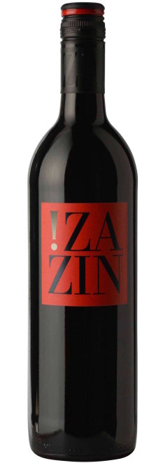
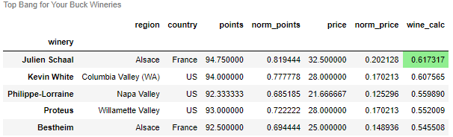
Top 5 ‘Bang for Your Buck’ Wineries
Normalized ‘points’ and ‘price’ columns into (‘norm_points’ and ‘norm_price’)
‘Wine_calc’ is the normalized difference between points and price
Julien Schaal, Kevin White and Phillippe-Lorraine are the top wineries in the World

Slide 21
Conclusions
The models all predicted at much higher accuracy and precision after altering our dataset
Ultimately, the MultiLayer Perceptron was our highest performing model with an average of 88% precision score
Sentiment Analysis gave us very little insight on our dataset
Topic Models:
Wines in Mendoza defined by (‘plum’, ‘note’ and ‘blackberry’)
Wines in Toscana defined by (‘cabernet’, ‘black’ and ‘merlot’)
Wines in Finger Lakes defined by (‘apple’, ‘riesling’ and ‘cherry’)
Julien Schaal Winery is the ‘best bang for your buck’ winery in the US

Slide 22
THANK YOU

